Slide 1
Automated Diagnosis of COVID-19 using Medical Imagery
Alister George Luiz
Supervisor: Dr. Hani Ragab

Slide 2
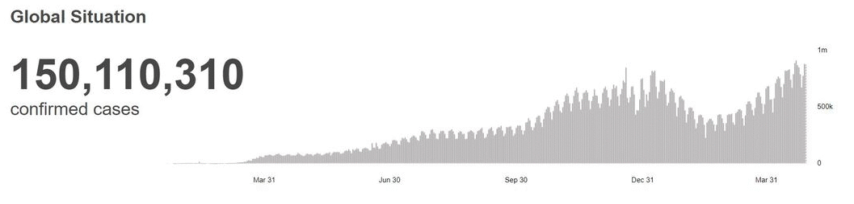
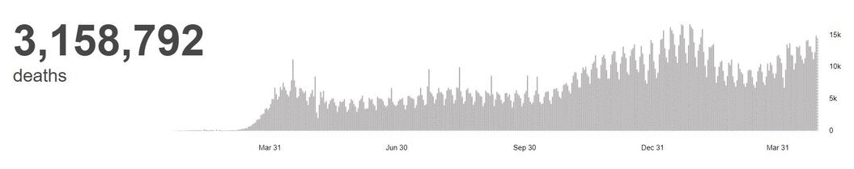
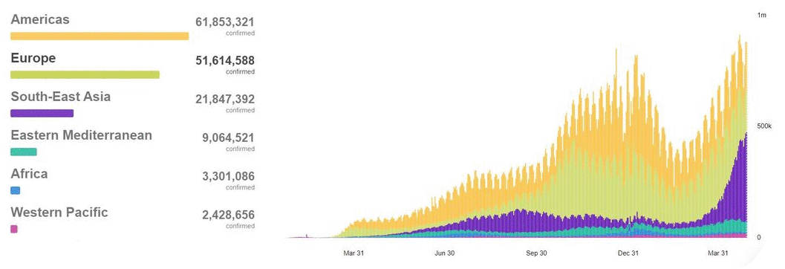
Trends in Coronavirus Cases
Worldwide
WHO Coronavirus (COVID-19) Dashboard | WHO Coronavirus (COVID-19) Dashboard With Vaccination Data

Slide 3
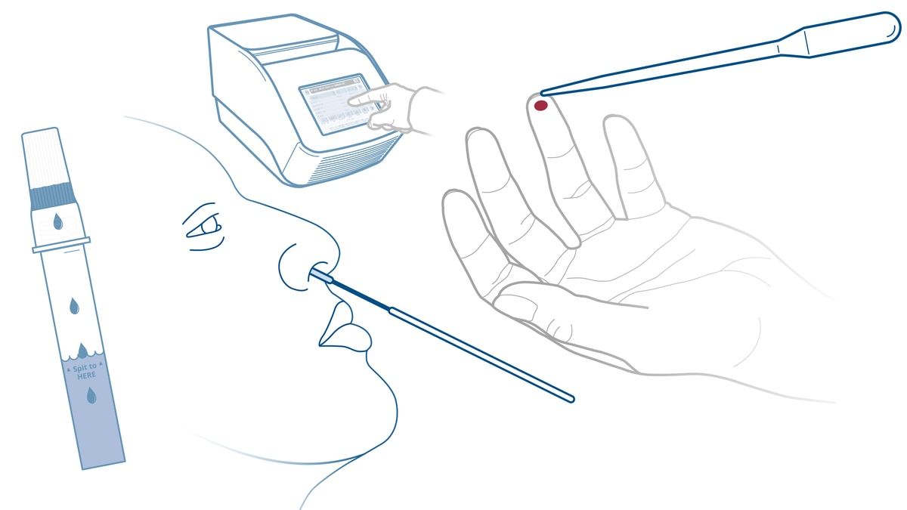
RT-PCR Test
Recommended by the World Health Organization.
However, this test involves serious downsides,
Shortage of RT-PCR test kits.
Delays in receiving test results (up to 2 days).
Has a sensitivity of 84.9% according to IDSA.
High False Negative Rate as per the study by Kucirka et al.
RT-PCR Testing (idsociety.org)
Variation in False-Negative Rate of Reverse Transcriptase Polymerase Chain Reaction–Based SARS-CoV-2 Tests by Time Since Exposure | Annals of Internal Medicine (acpjournals.org)

Slide 4
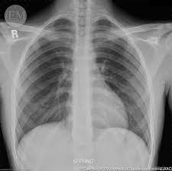
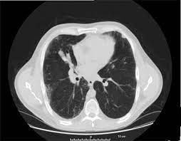
Medical Imagery
A safer and faster approach...
COVID-19 diagnosis using X-rays or CT scans,
Minimizes rate of virus exposure.
Provides safer environment for healthcare professionals.
Returns highly accurate real-time diagnosis as per our findings.

Slide 5
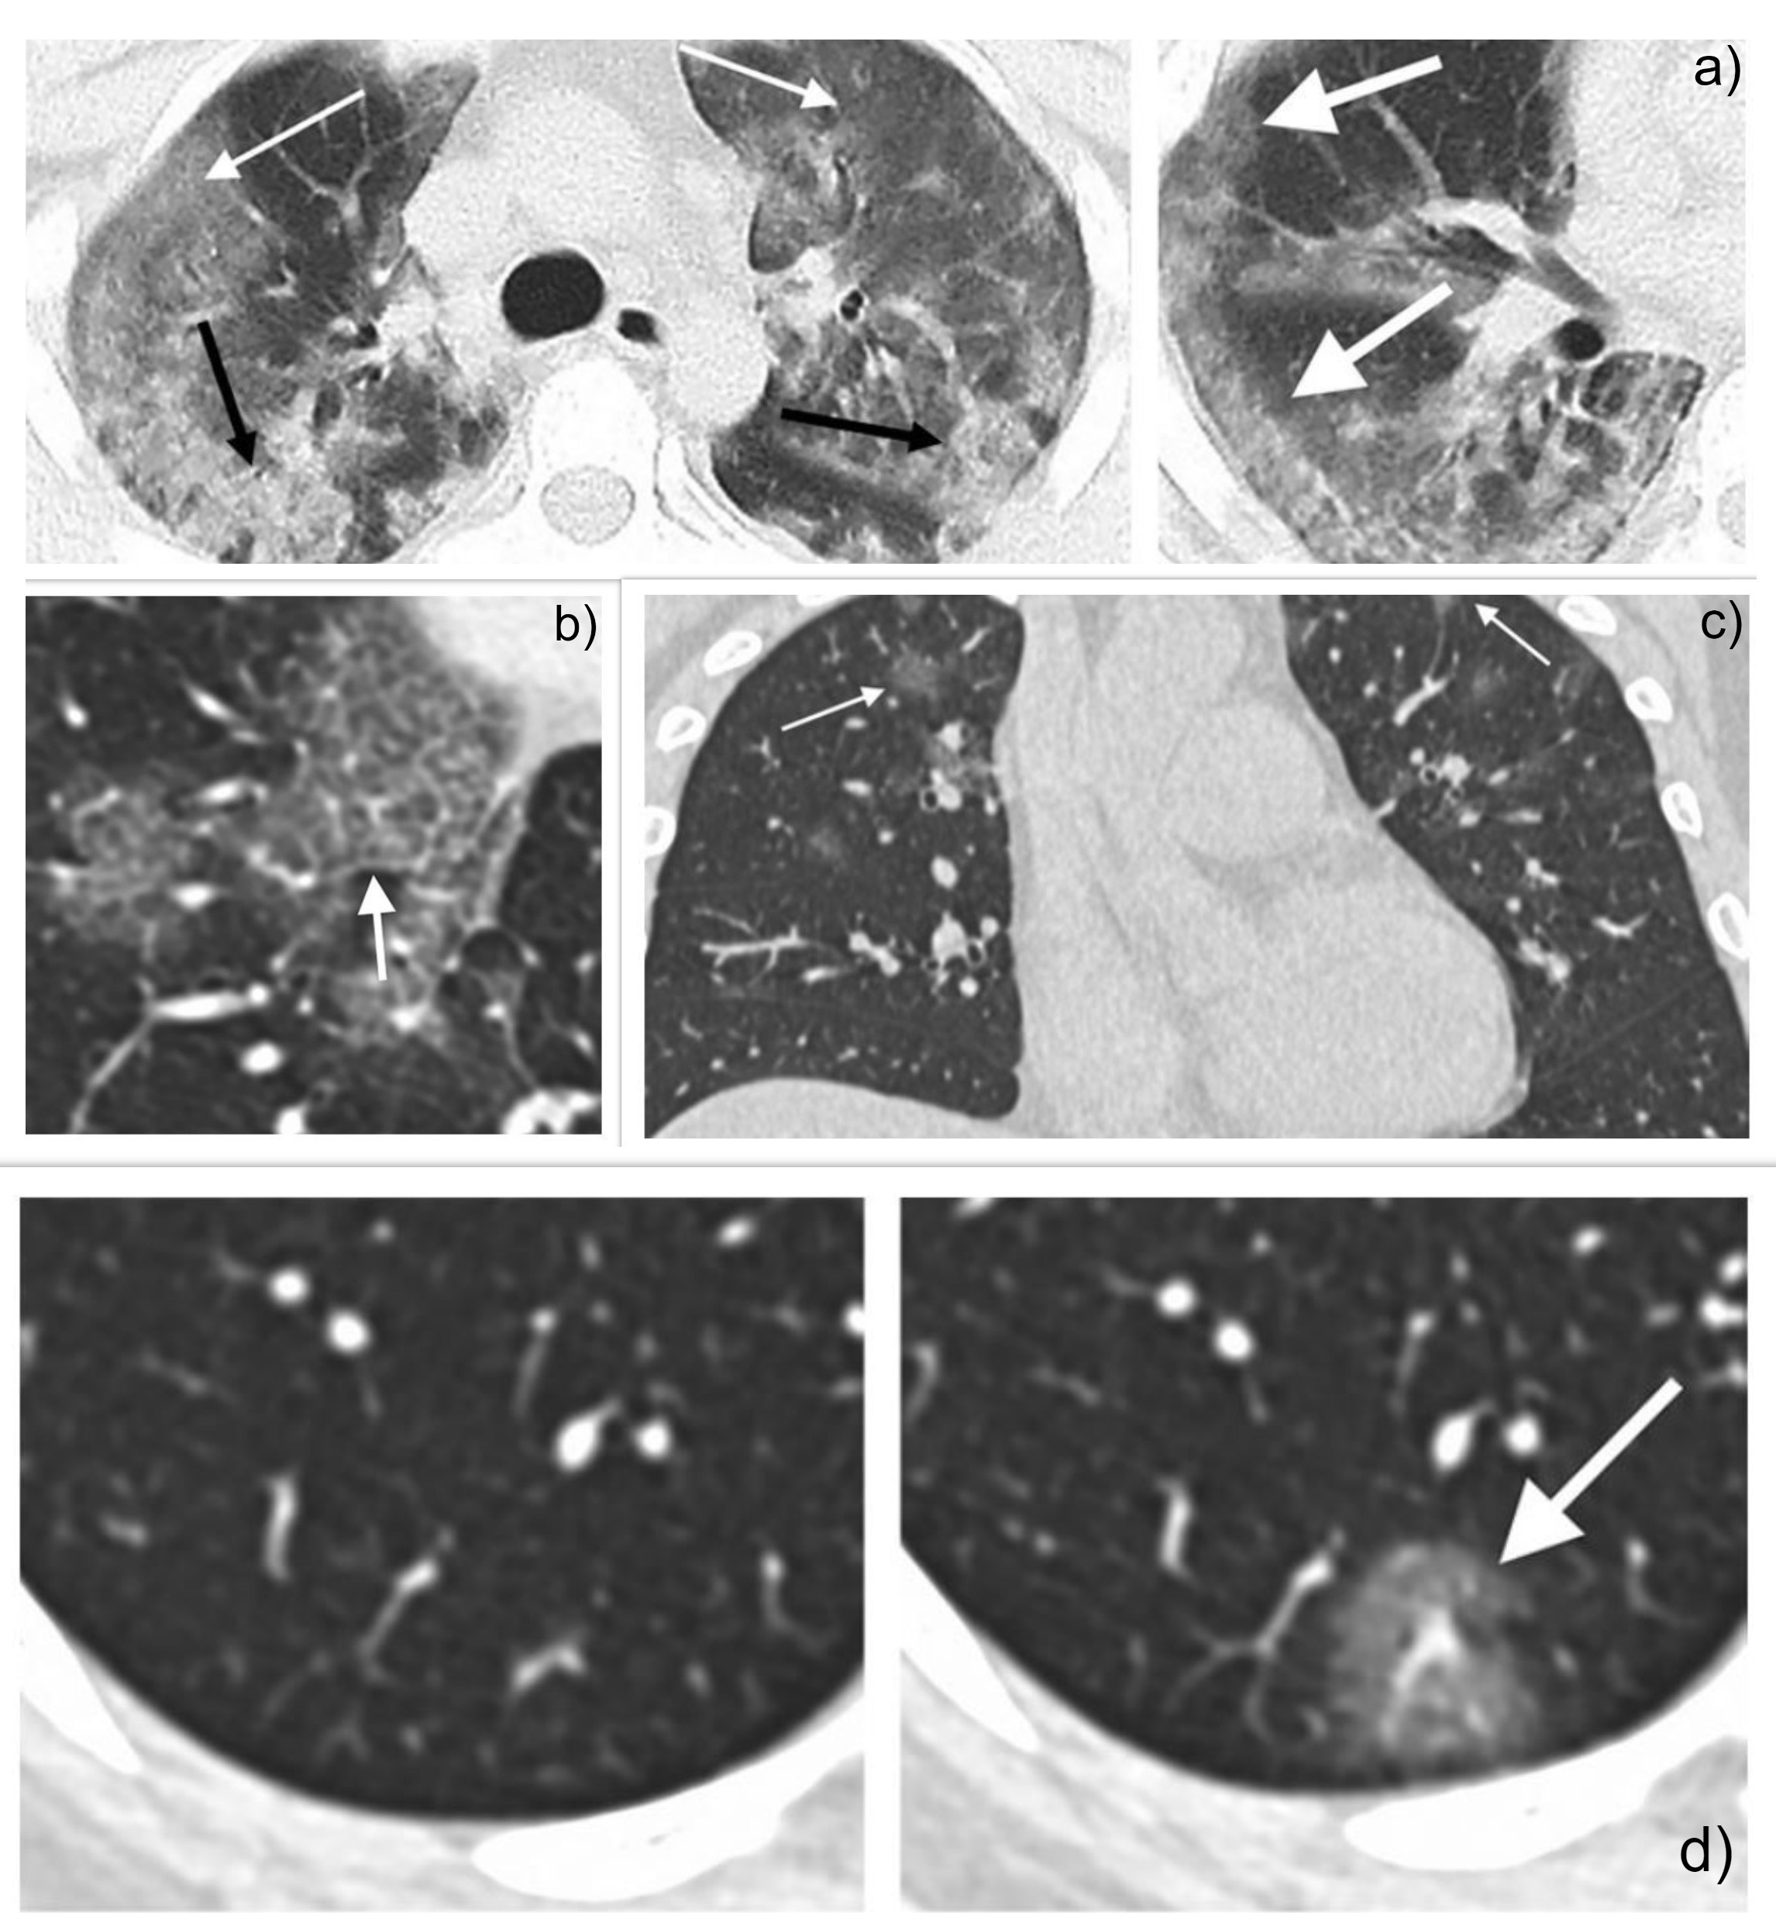
Lung
Characteristics
As per Chung et al.
Ground-glass Opacities (GGOs).
Crazy-paving patterns.
Interlobular sepal thickening.
Ground-glass Lesions.
Consolidative Pulmonary Opacities.
CT Imaging Features of 2019 Novel Coronavirus (2019-nCoV) | Radiology (rsna.org)

Slide 6
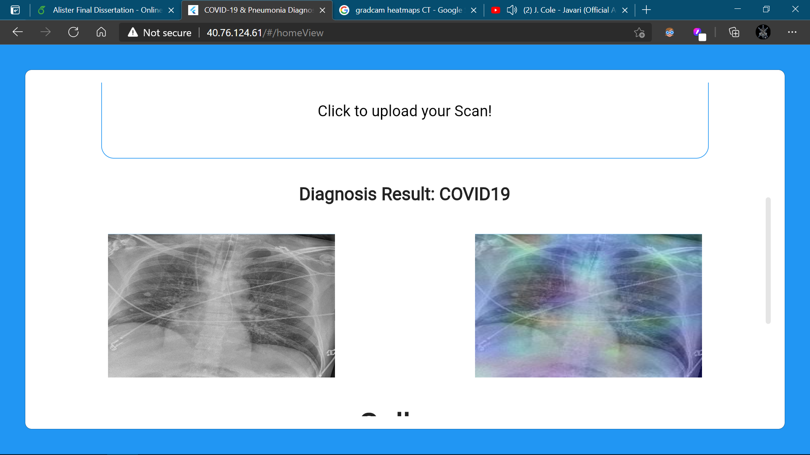
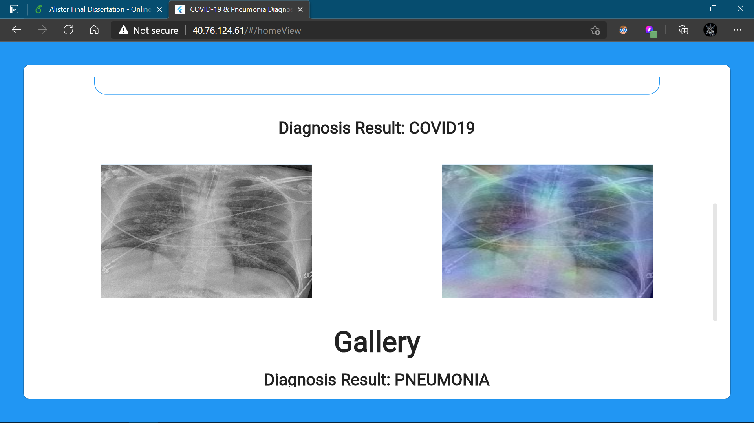
Interpreting Results
Visualize the reasoning behind the deep learning model’s prediction.
Grad-CAM heatmaps highlight regions that led to the classification.
Allows radiologists to cross-check their findings.
Improves reliability of diagnosis.
Red sections highlight most influential regions.
Blue sections highlight least influential regions.

Slide 7
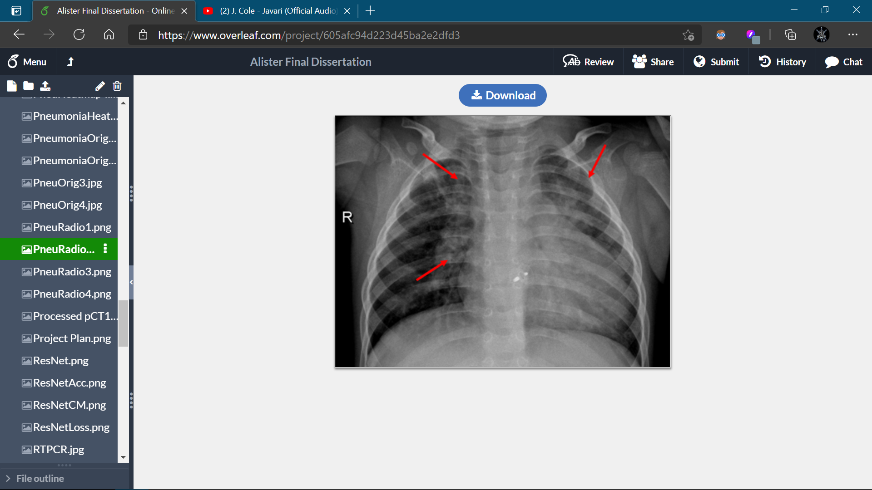
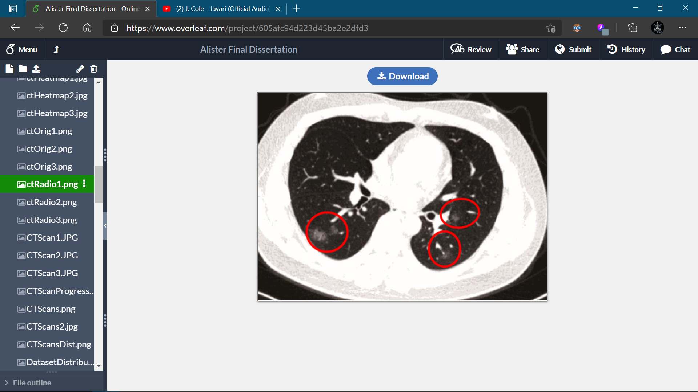
Radiologist Validation
Our results have been validated with the help of a Senior Radiologist.
We would like to thank Dr. G.R. Mahadevan (MD, IDCCM, D.Diab, Specialist in COVID-19) from Maya Nursing Home, Tamil Nadu for annotating the X-ray and CT images.
Our Grad-CAM heatmap results were compared with findings observed by the Radiologist.

Slide 8

Keras Callbacks
Enhances model training...
Helped the models to converge faster and overcome learning plateaus.
Performs actions or functions at various stages of training.
Usually between epochs or when training begins or ends.
Three Callback functions utilized.
EarlyStopping, ReduceLROnPlateau, and ModelCheckpoint.

Slide 9
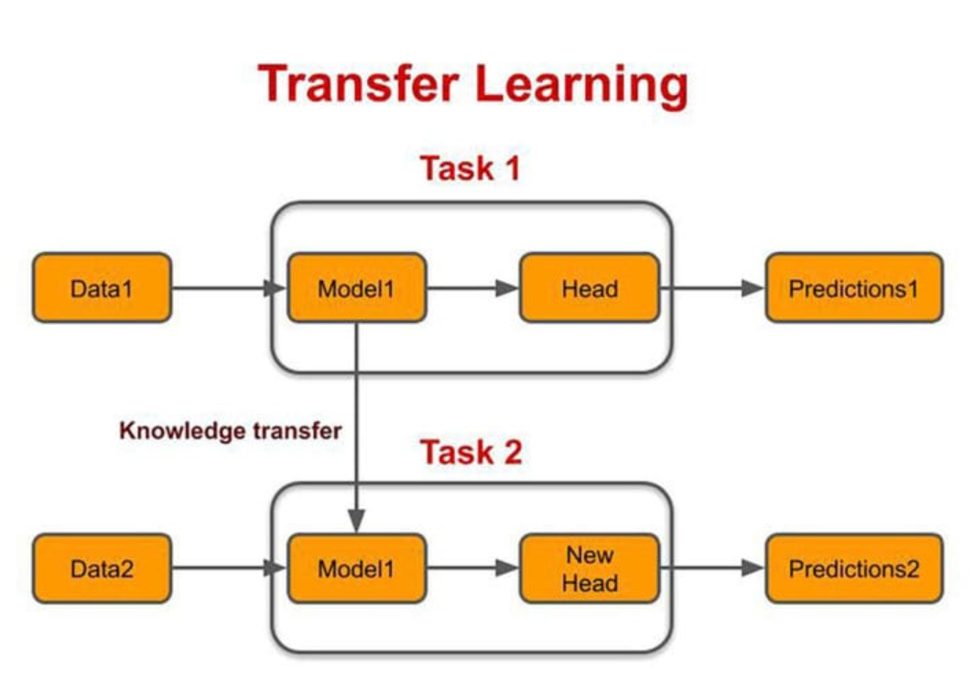
Transfer Learning
Utilized the ImageNet Dataset.
Reduces training time and improve accuracy.
Used a model trained with large volume of images from the ImageNet dataset.
Only the final layer was trained.
Fixed weights for other layers.

Slide 10
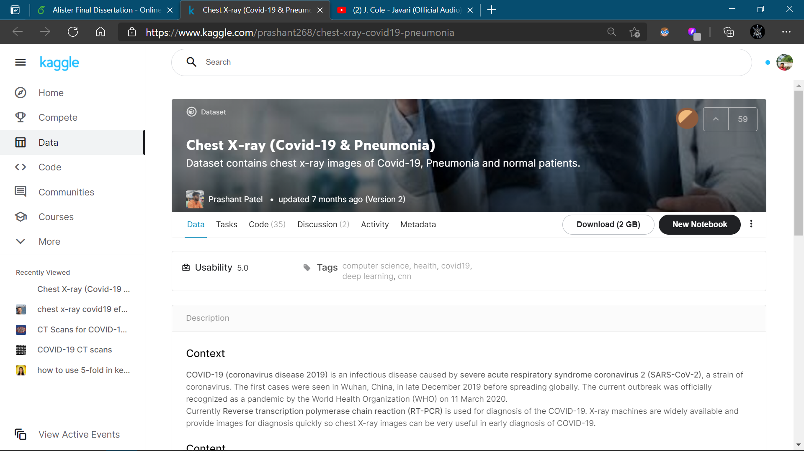
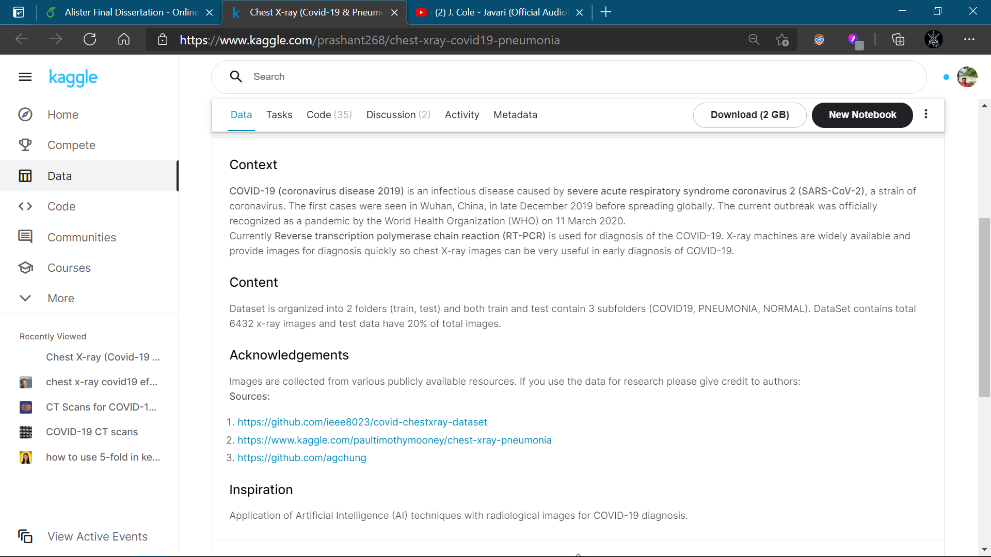
X-ray Dataset
Our model is trained and tested on images from a Kaggle dataset
Chest X-ray (Covid-19 & Pneumonia) | Kaggle

Slide 11
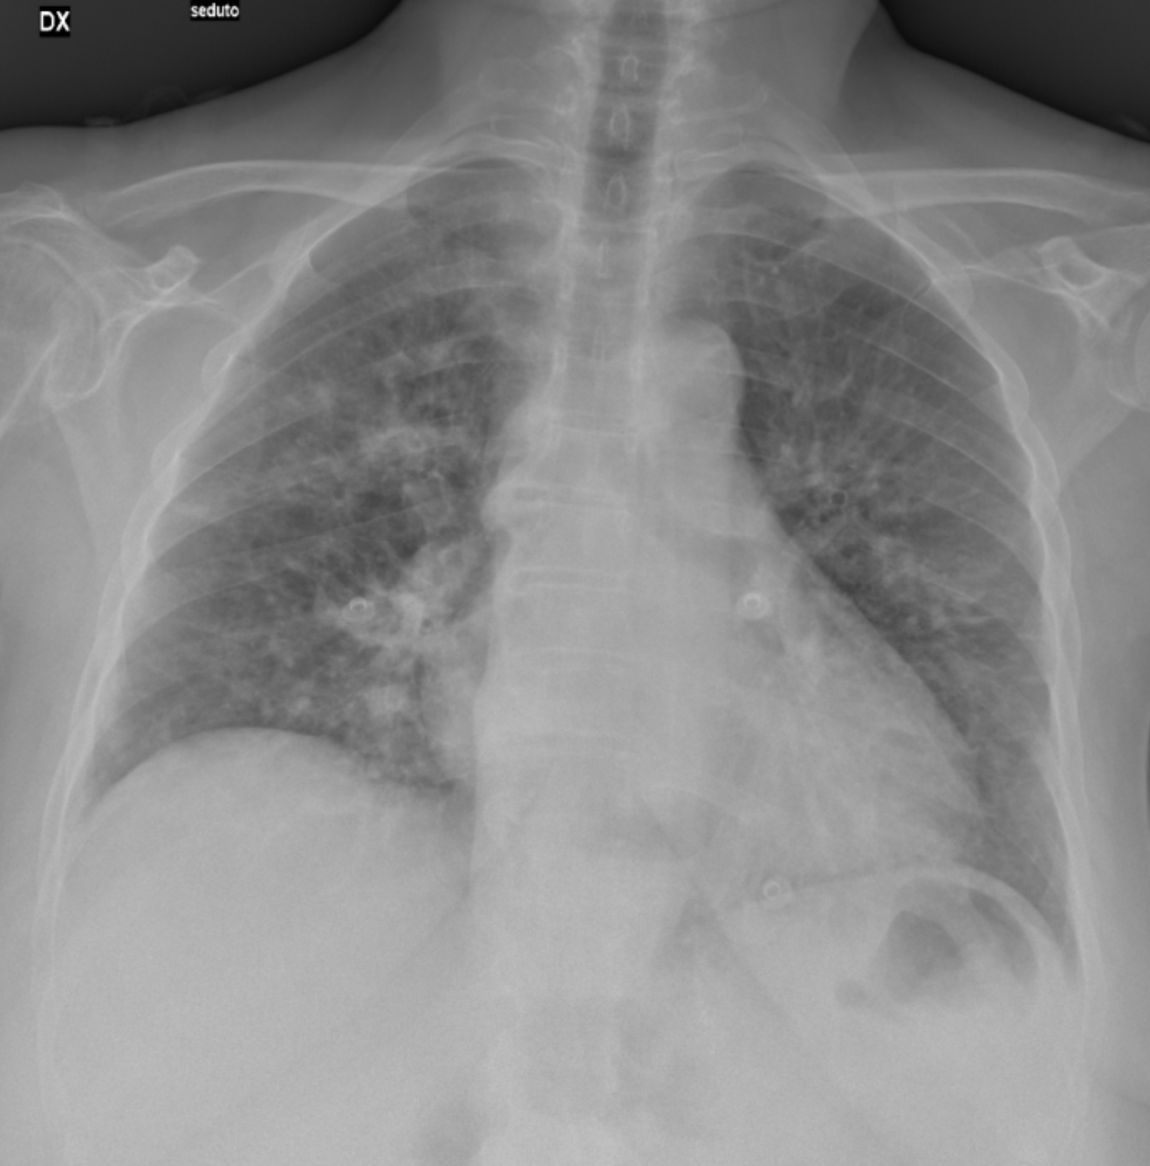
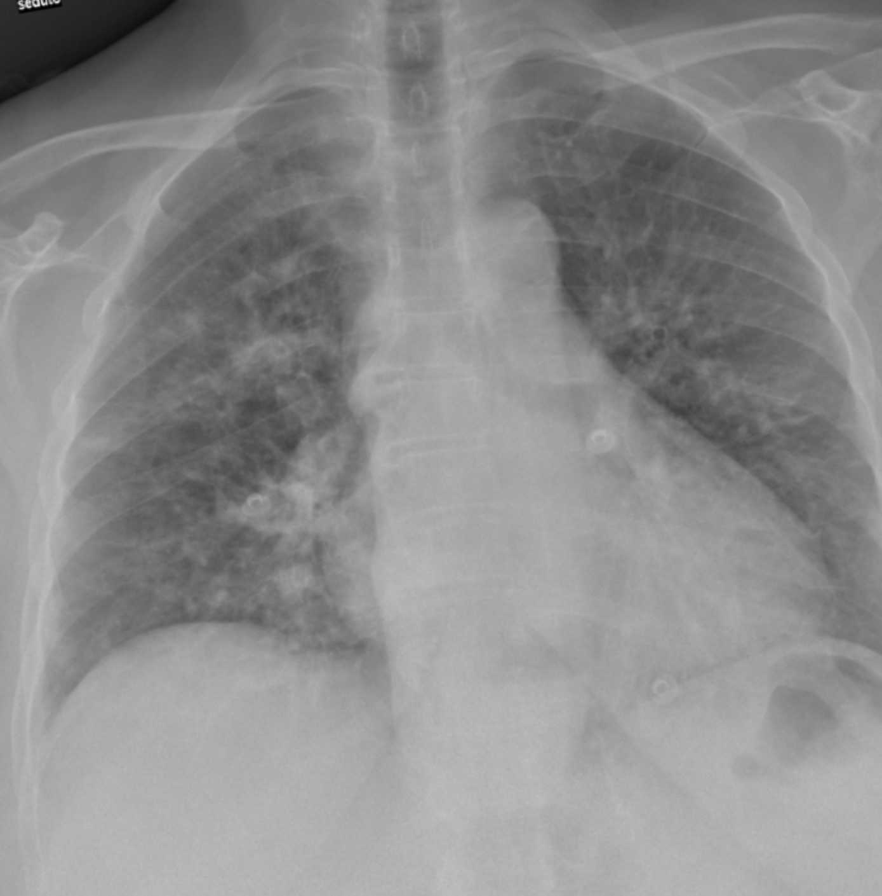
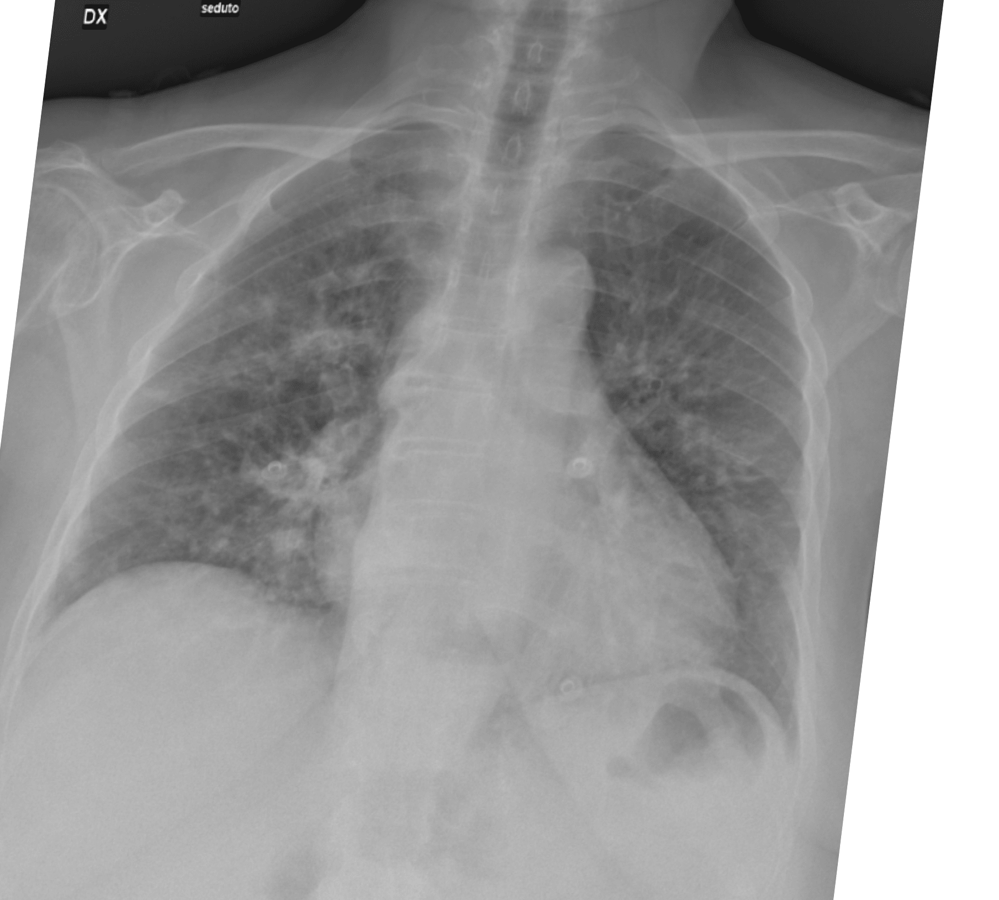
Data Augmentation
Generates more training samples...
Each training image undergoes three operations.
5° rotation, +2% zooming, and 2° Shearing
5° Rotation
+2% Zooming
2° Shearing

Slide 12
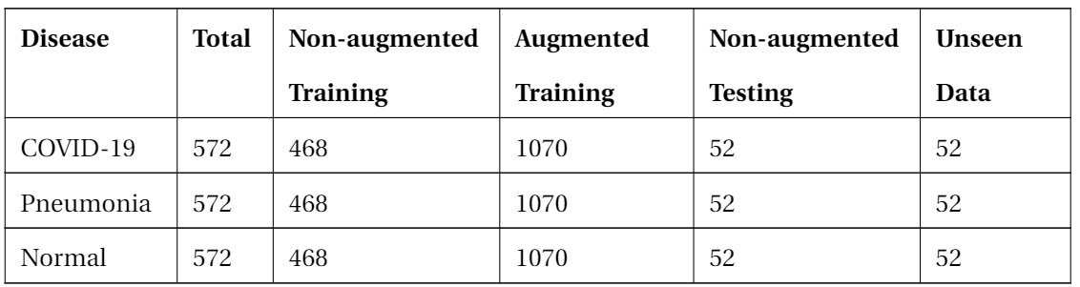
Dataset Distribution
A balanced dataset of 572 images per class was prepared.

Slide 13
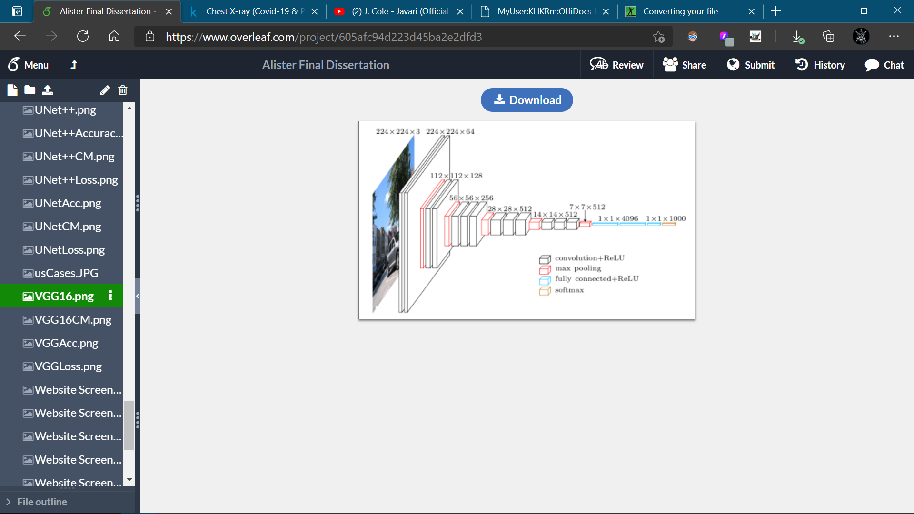
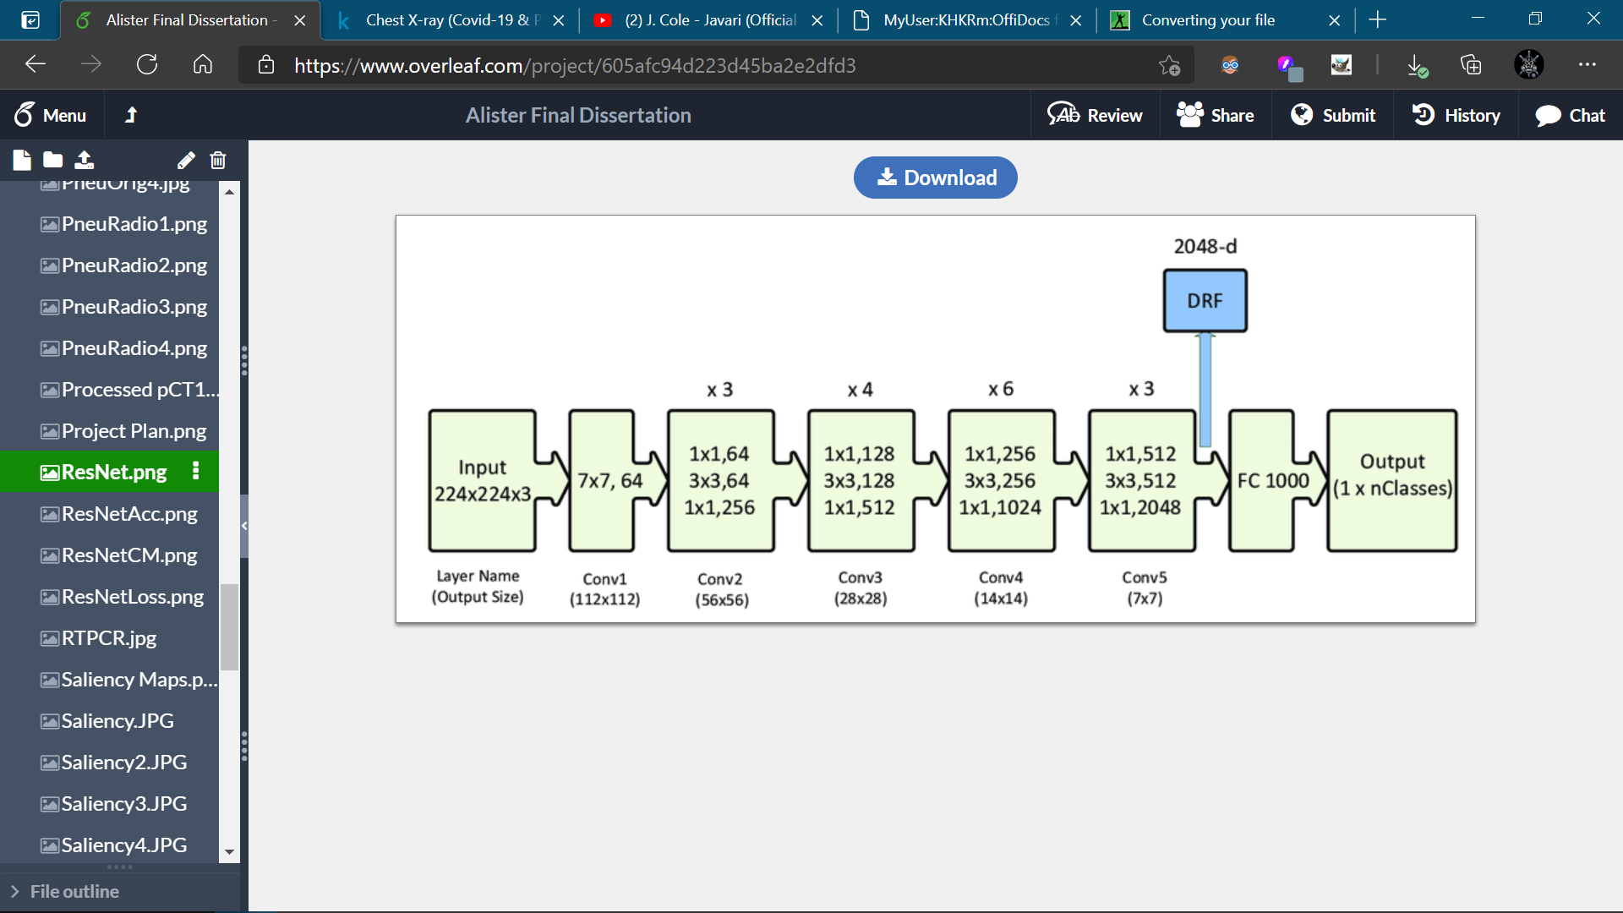
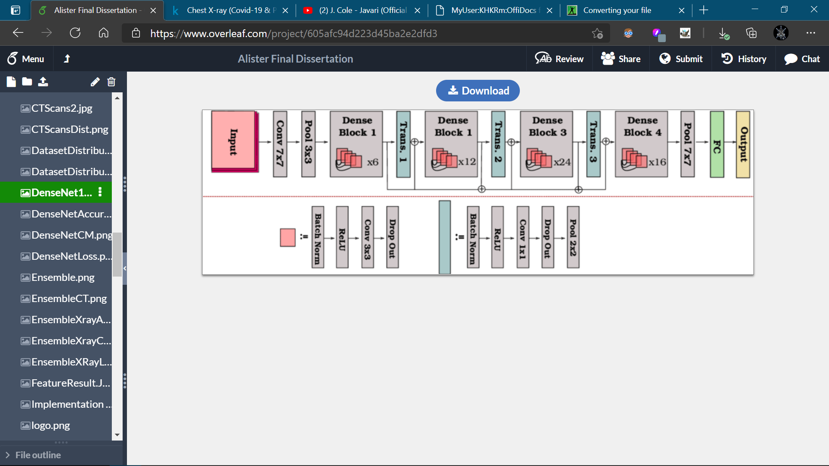
X-ray Models
DenseNet121, ResNet50, and VGG16.
We have experimented with 3 deep learning models.
Performance improved via ensembling the base models.
VGG16
DenseNet121
ResNet50

Slide 14

Results
Significant performance improvement with Ensemble Model.

Slide 15
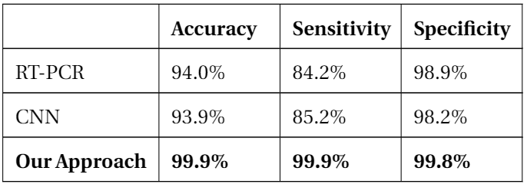
Performance Comparison
Comparison with RT-PCR test and CNN.
Metrics for the RT-PCR test obtained from the study conducted by IDSA.
A basic CNN model was also implemented.
Only COVID-19 class utilized for performance comparison.
RT-PCR Testing (idsociety.org)

Slide 16
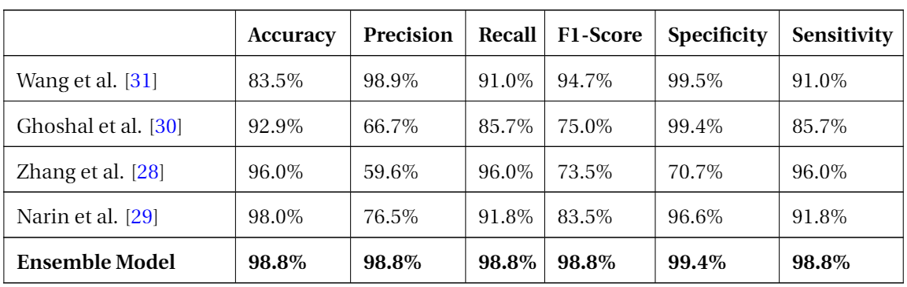
Performance Comparison
Comparison with Related Studies.
Our Ensemble model outperforms results obtained by related studies across most metrics.

Slide 17
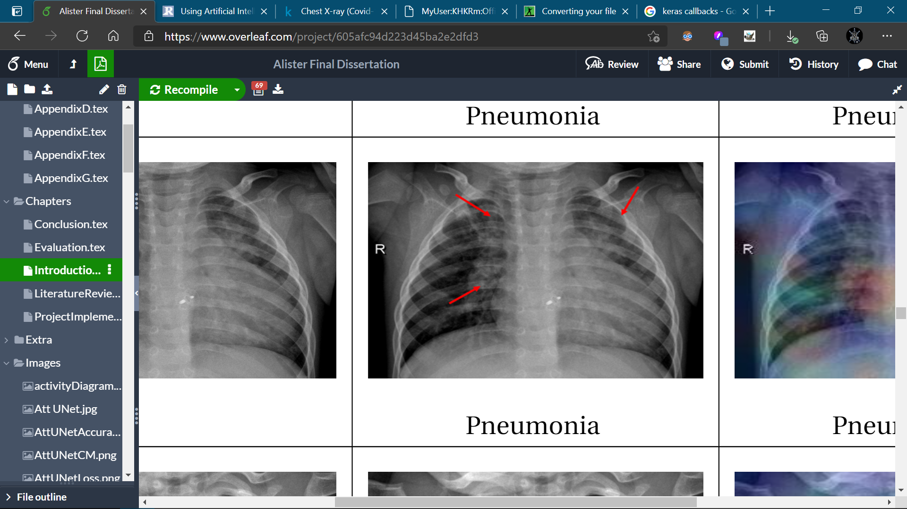
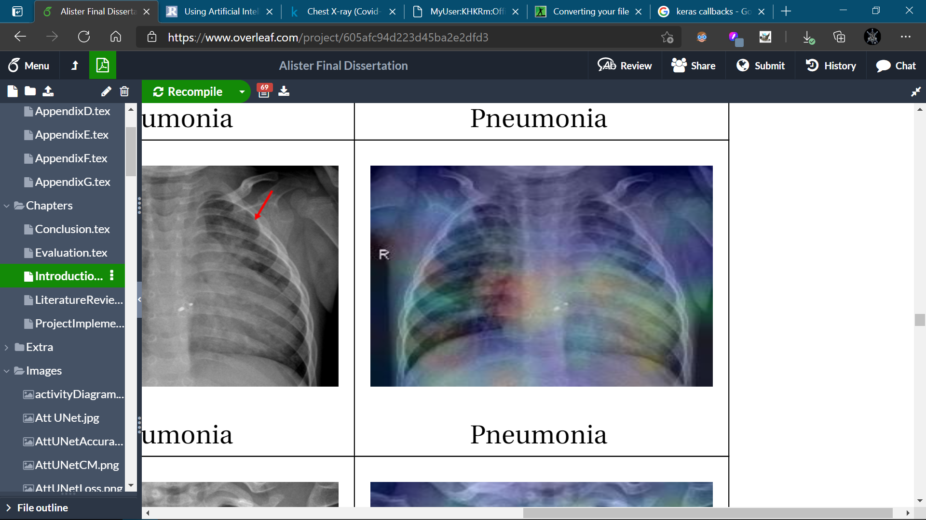
Performance Comparison
Comparison with Radiologist Findings.
Heatmaps obtained validated using Radiologist Findings.
Heatmaps also correspond to regions highlighted by Harmon et al. and Li et al.
Li et al. | Radiology (rsna.org)
Harmon et al.| Nature Communications

Slide 18
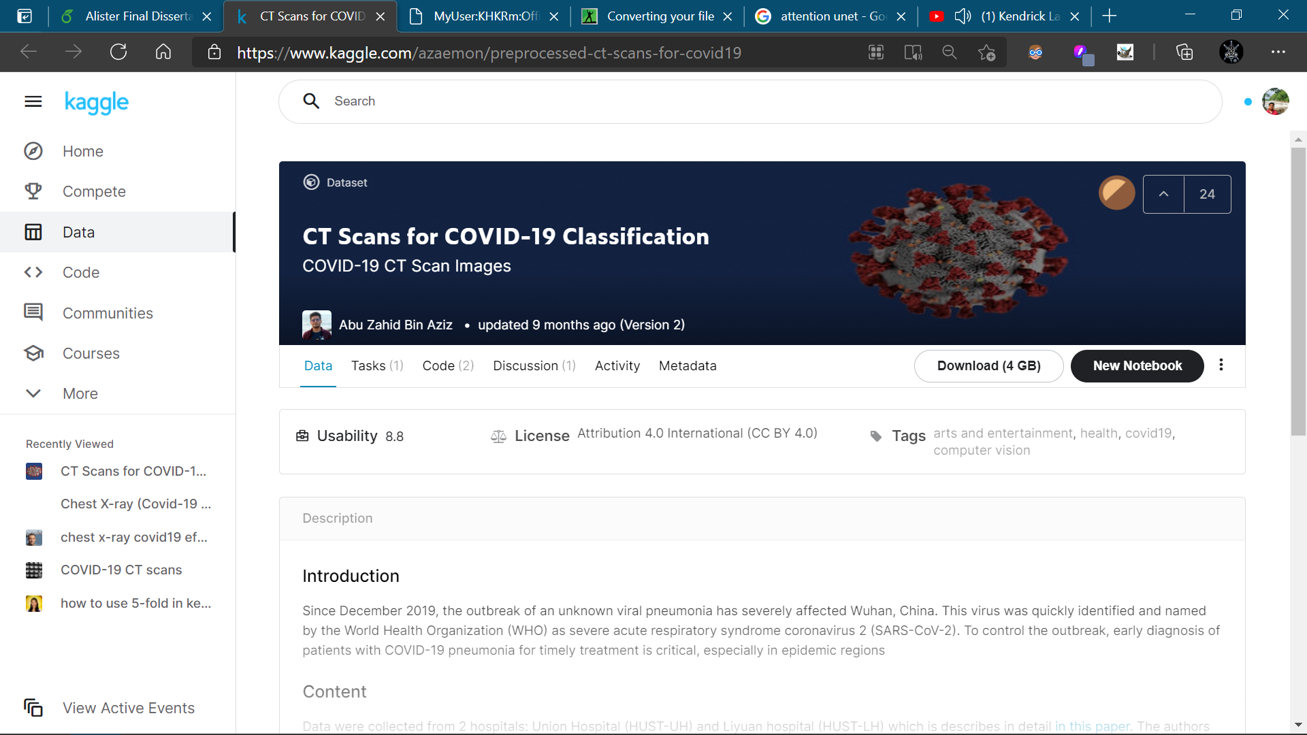
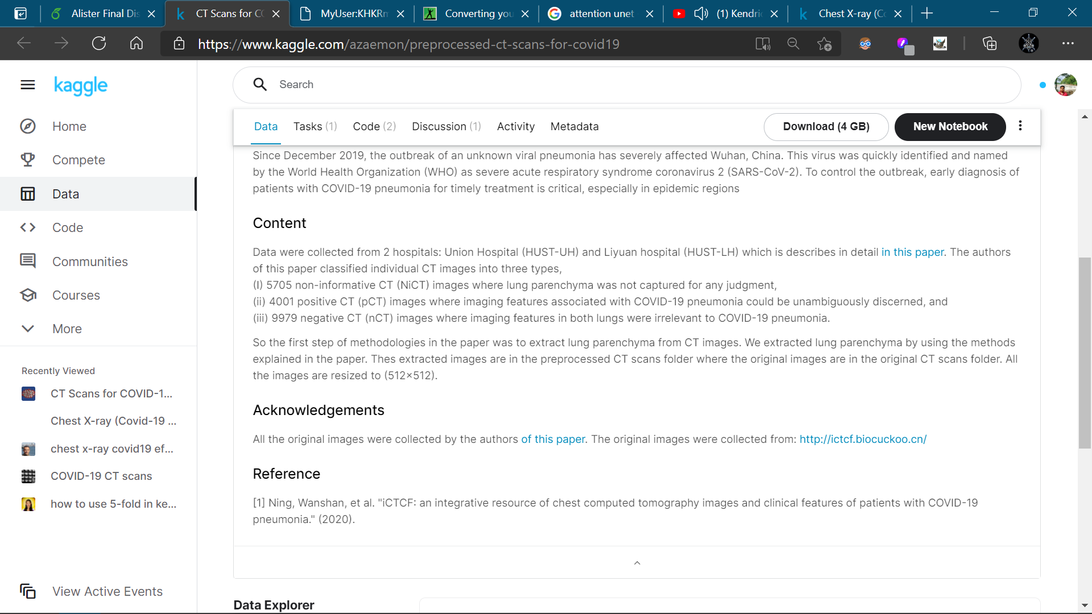
CT Dataset
Our model is trained and tested on images from a Kaggle dataset
CT Scans for COVID-19 Classification | Kaggle

Slide 19
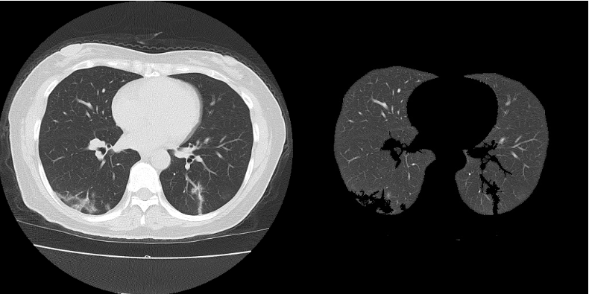
Lung Parenchyma
Extraction
Vital pre-requisite for CT scan classification.
CT Scans for COVID-19 Classification | Kaggle

Slide 20
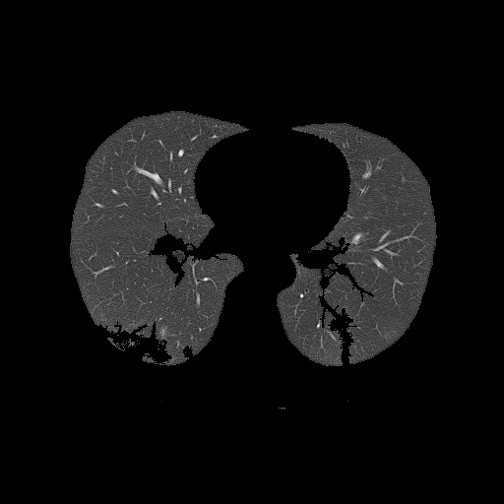
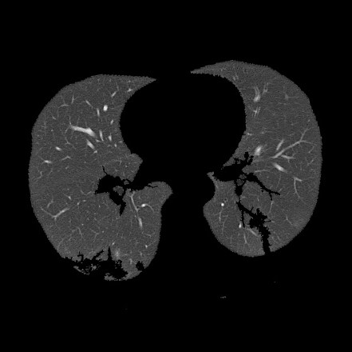
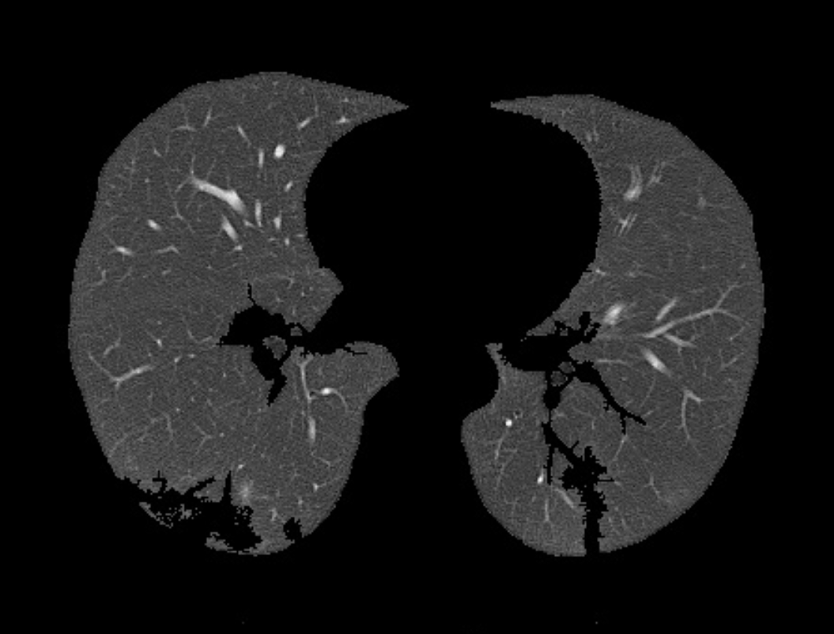
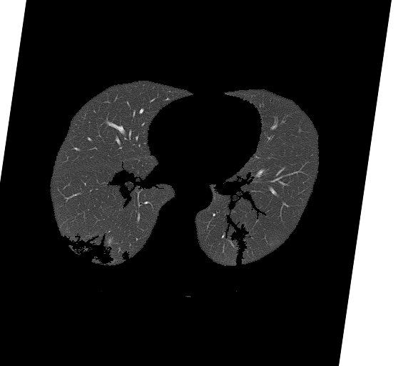
Data Augmentation
Generates more training samples...
Each training image undergoes three operations.
5° rotation, +2% zooming, and 2° Shearing
5° Rotation
+2% Zooming
2° Shearing

Slide 21
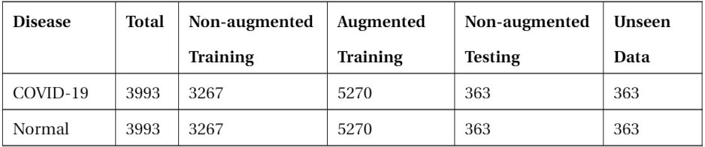
Dataset Distribution
A balanced dataset of 3993 images per class was prepared.

Slide 22
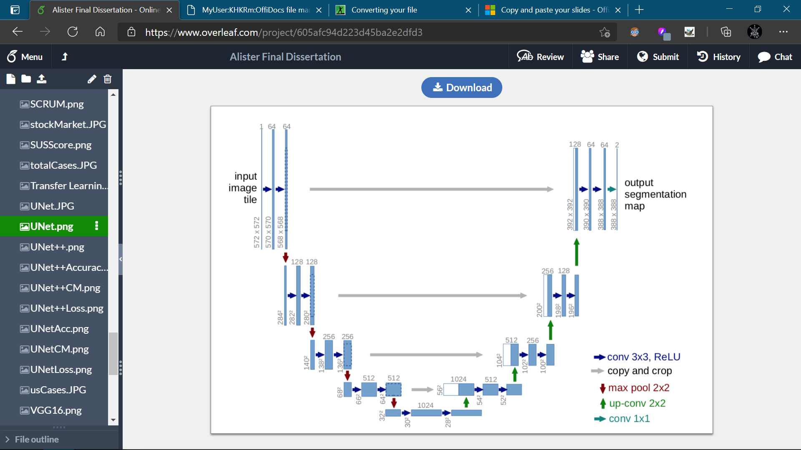
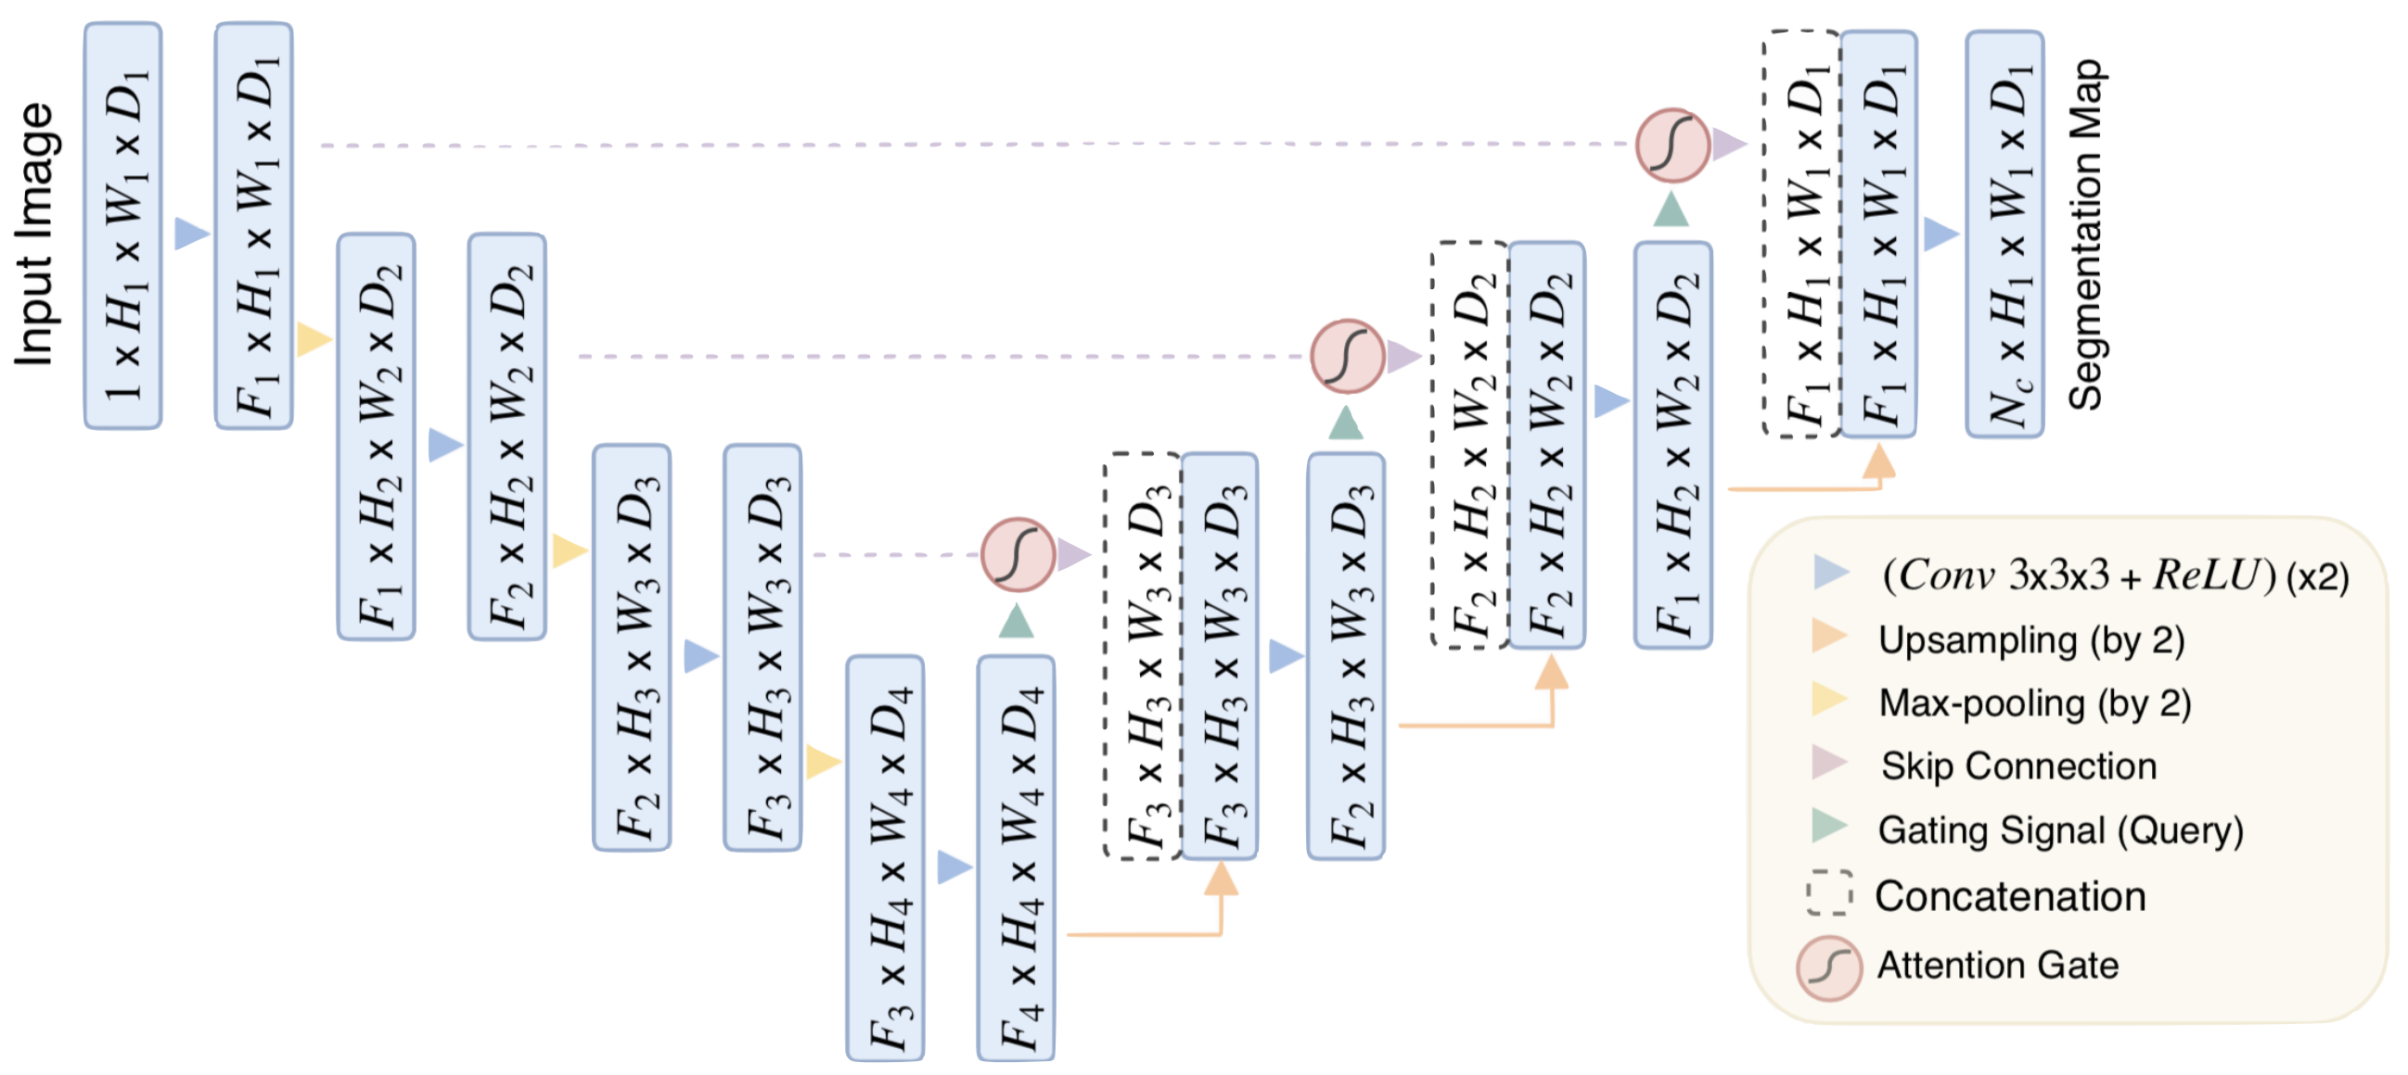
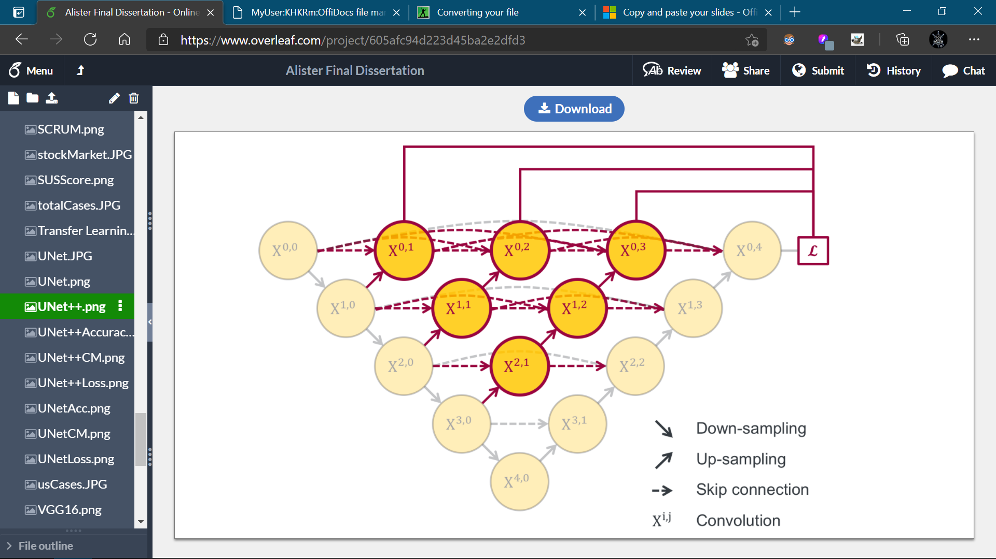
CT Models
UNet, UNet++, and Attention UNet.
We have experimented with 3 deep learning models.
Performance improved via ensembling the base models.
UNet
Attention UNet
UNet++

Slide 23
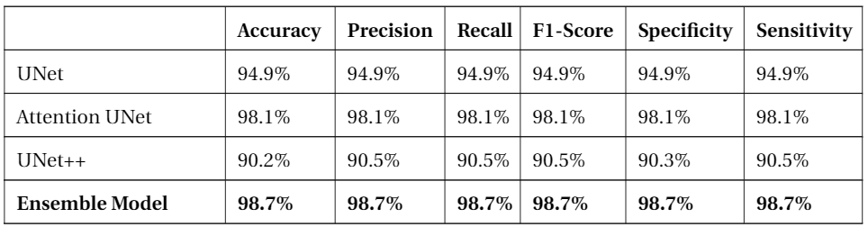
Results
Significant performance improvement with Ensemble Model.

Slide 24
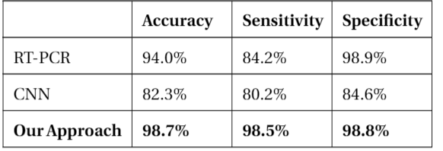
Performance Comparison
Comparison with RT-PCR test and CNN.
Metrics for the RT-PCR test obtained from the study conducted by IDSA.
A basic CNN model was also implemented.
RT-PCR Testing (idsociety.org)

Slide 25
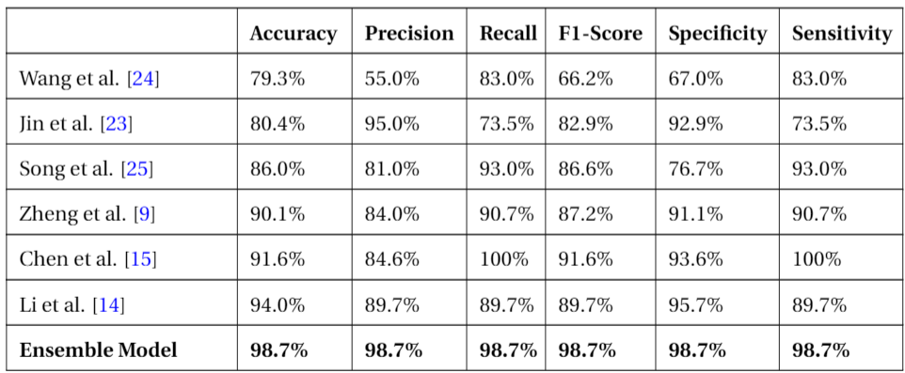
Performance Comparison
Comparison with Related Studies.
Our Ensemble model outperforms results obtained by related studies across all metrics.

Slide 26
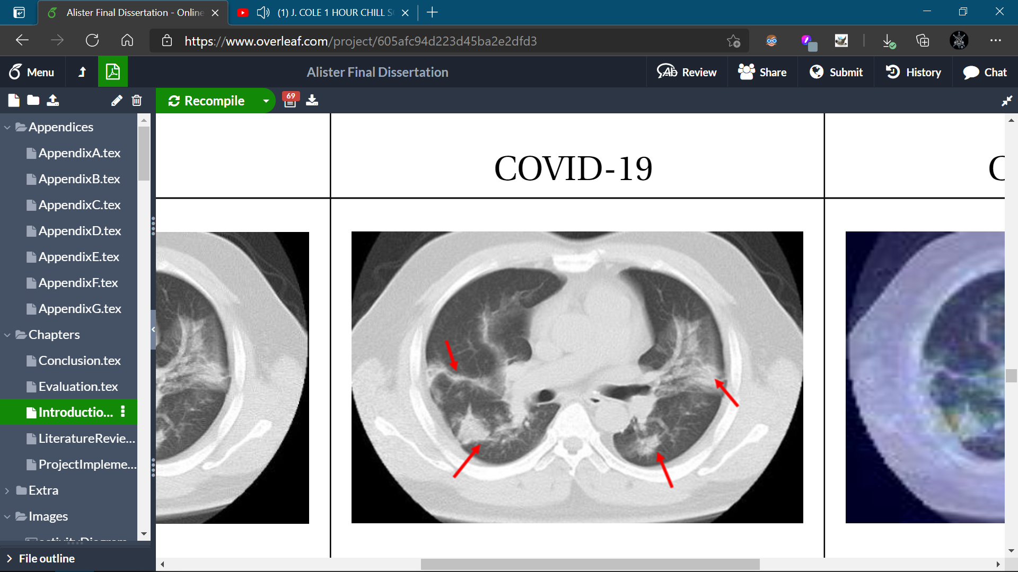
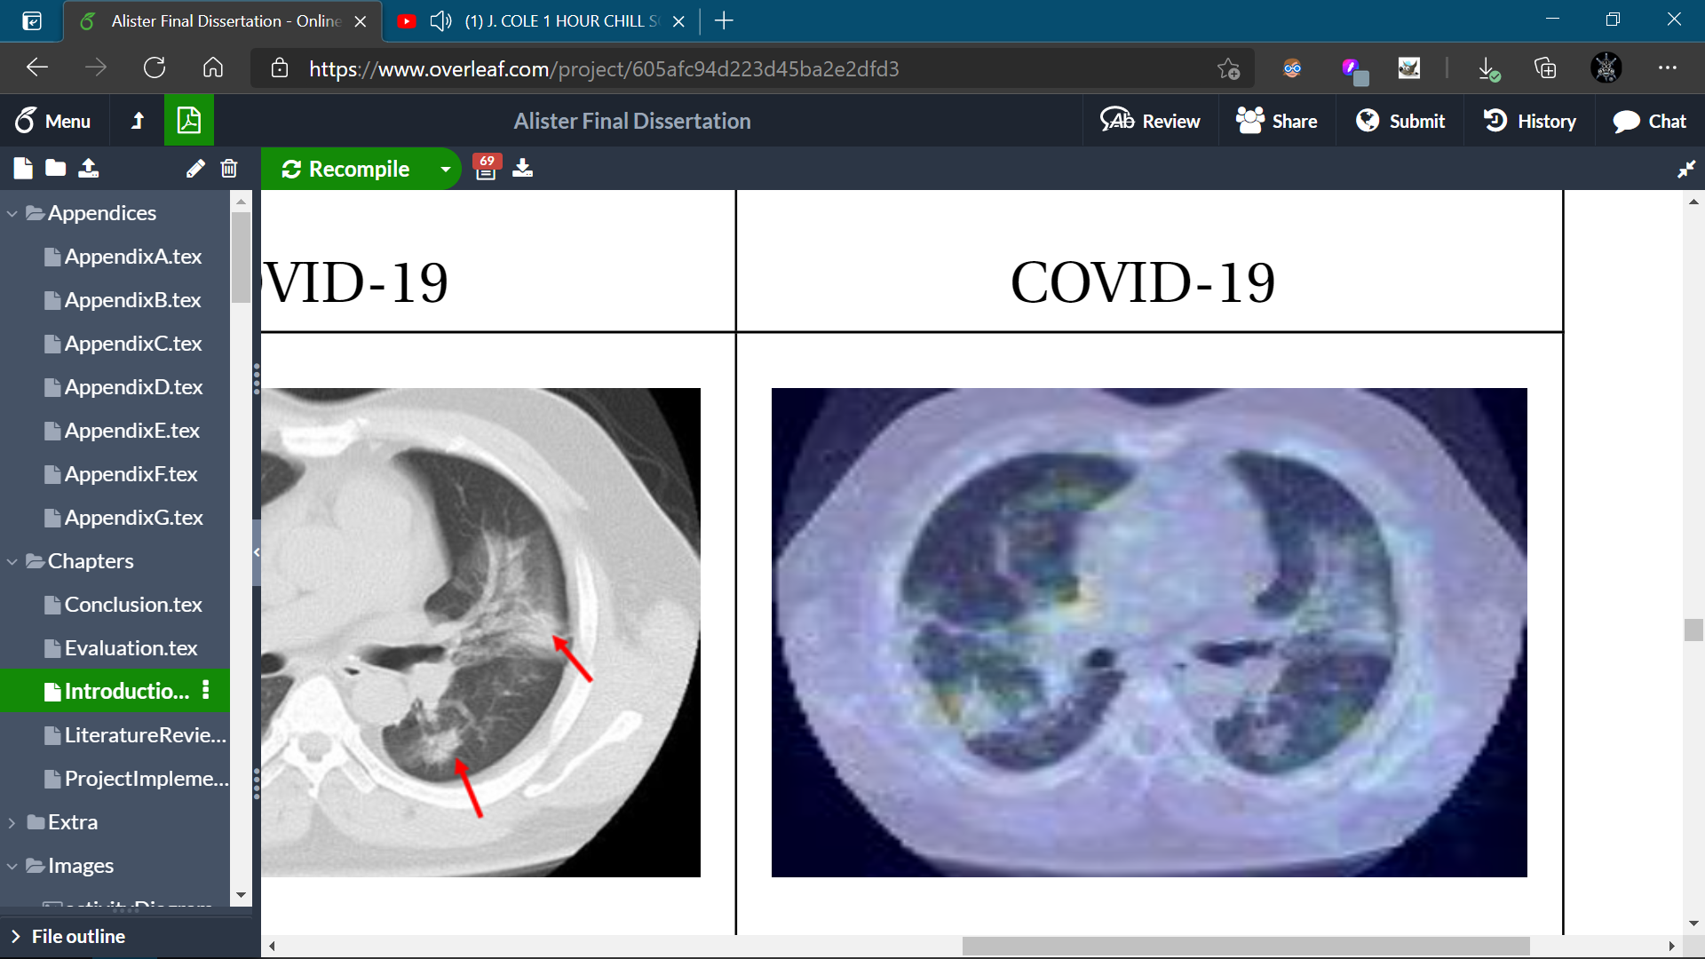
Performance Comparison
Comparison with Radiologist Findings.
Heatmaps obtained validated using Radiologist Findings.
Heatmaps also correspond to regions highlighted by Harmon et al., Li et al., and Chung et al.
Li et al. | Radiology (rsna.org)
Harmon et al.| Nature Communications
Chung et al. | Radiology (rsna.org)

Slide 27
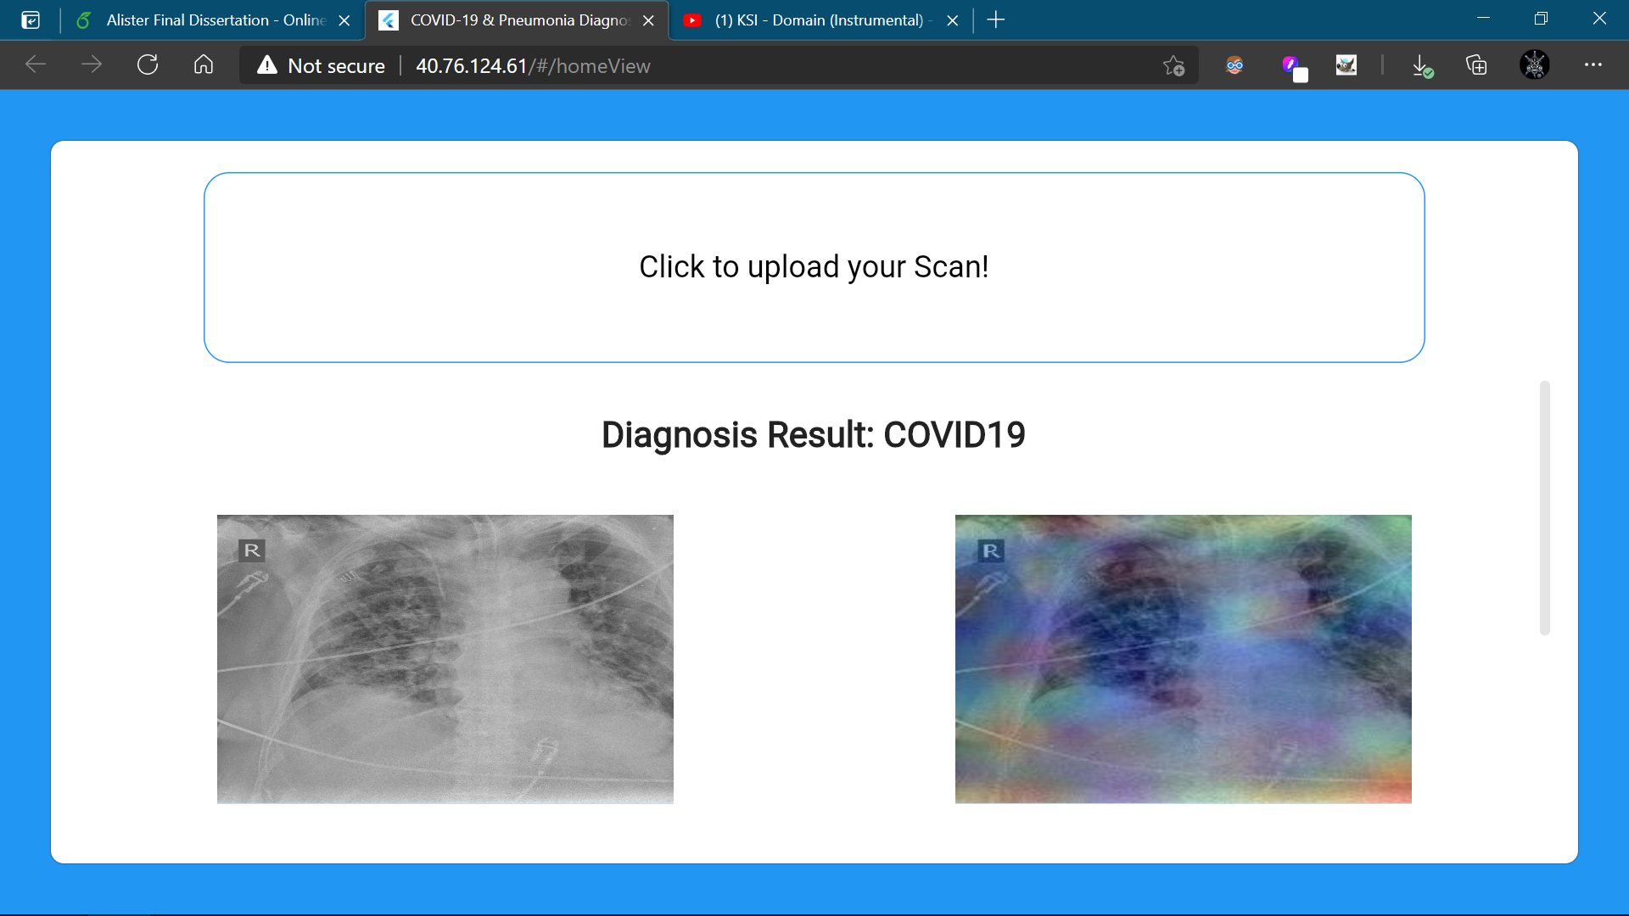
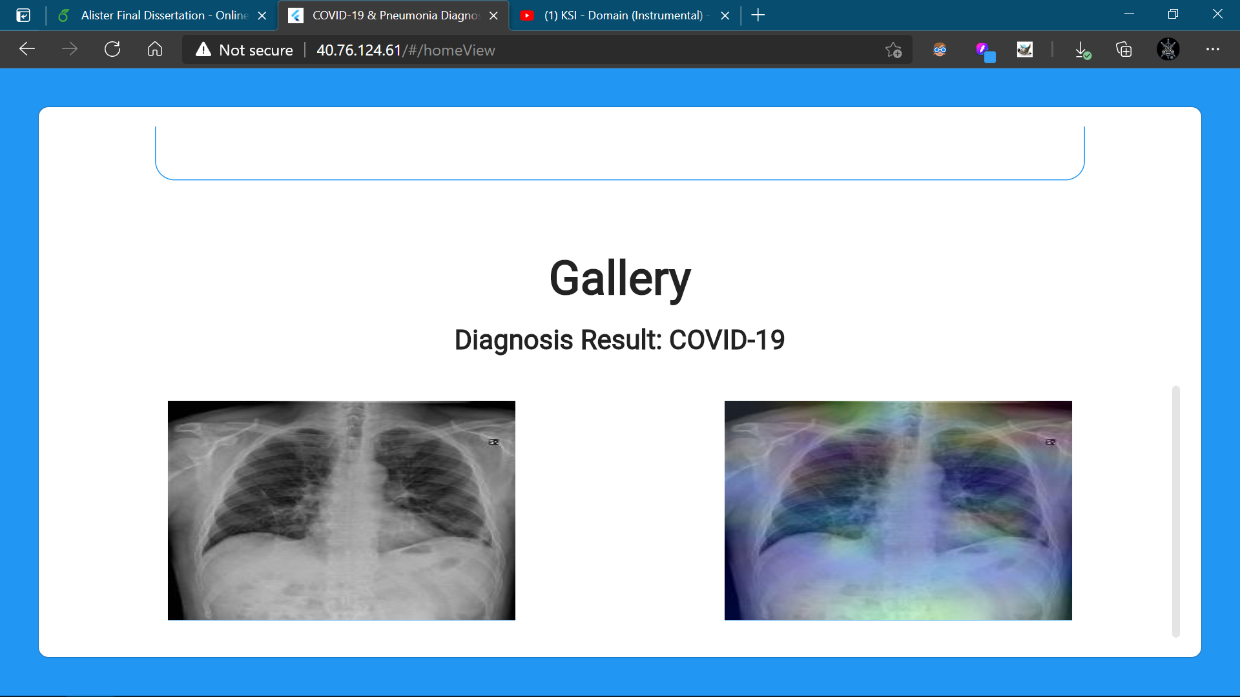
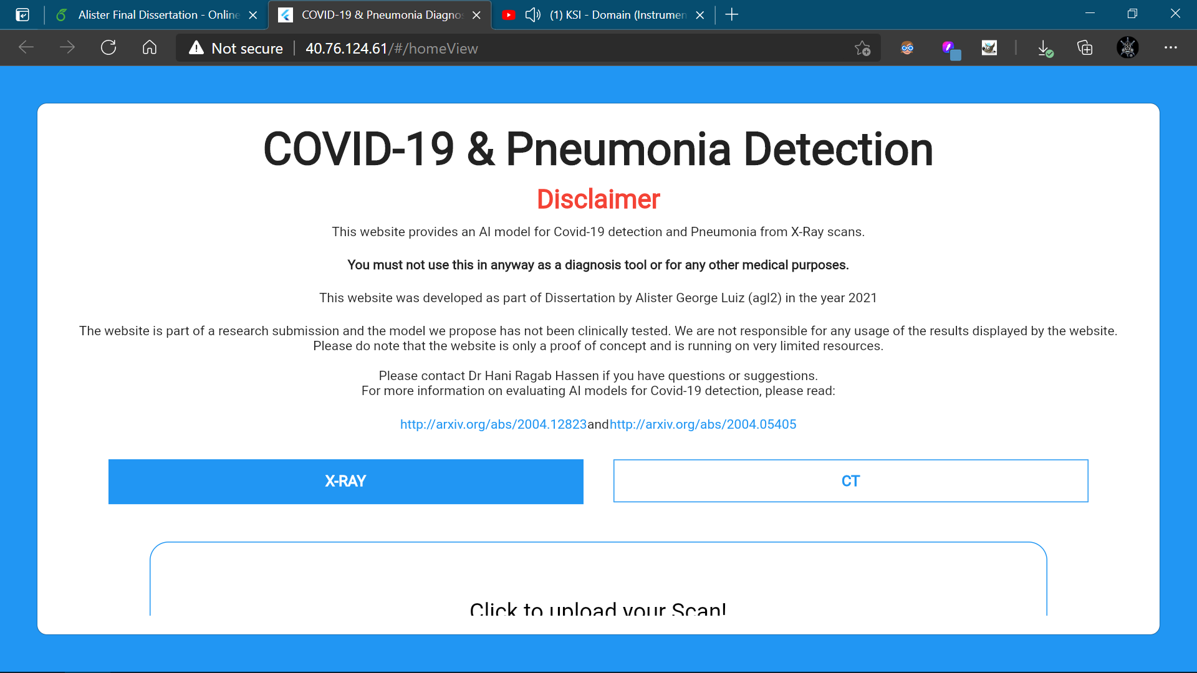
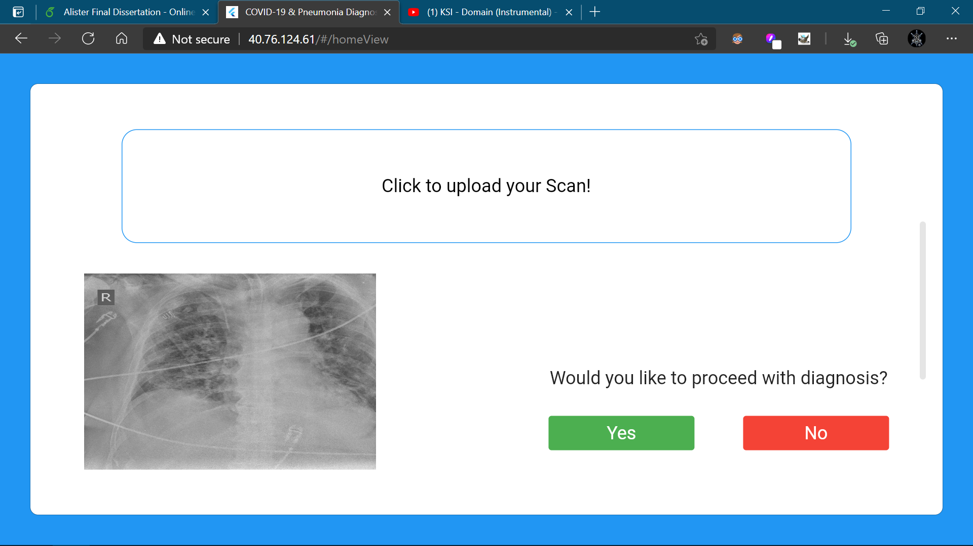
Web Interface
Simple portal that allows real-time diagnosis and heatmap visualization.
The front-end of the web application is built using Google’s Flutter UI Toolkit.
A Flask application is also deployed serving as backend.
http://40.76.124.61/

Slide 28


Source Code
Where to find our source code and resources.
AlisterLuiz/Dissertation
Dissertation - OneDrive

Slide 29
Conclusion
Summary of this project…
Proposed an ensemble learning approach for COVID-19 and Pneumonia diagnosis.
Higher accuracy than all the reported papers and RT-PCR test for both X-ray and CT scans.
Validated our results with the help of a senior Radiologist.
Drafted a research paper on the experiments conducted for X-ray classification.
Intend to publish it to the Computers in Biology and Medicine journal.

Slide 30


Thank You!
https://alisterluiz.com/
Alister Luiz | LinkedIn
Alister Luiz | Github

